Slide 1
APUSH Review: Key Concept 3.2
Period 3: 1754 – 1800
Everything You Need To Know About Key Concept 3.2 To Succeed In APUSH
Updated for the 2015 revisions

Slide 2
The New Curriculum
Key Concept 3.2 “The American Revolution’s democratic and republican ideals inspired new experiments with different forms of government.”
Page 38 of the Curriculum Framework
Big ideas:
How did Enlightenment ideas help lead to the American Revolution?
How was the Constitution able to pass in light of conflicting interests? (North v. South, Federalists v. Anti-Federalists)

Slide 3
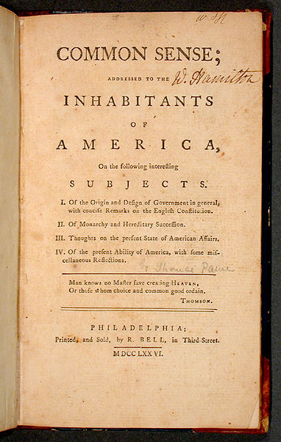
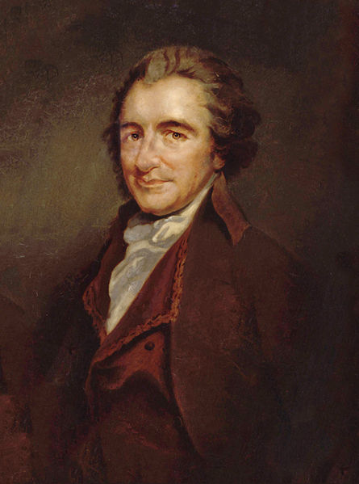
Key Concept 3.2, I
“The ideals that inspired the revolutionary cause reflected new beliefs about politics, religion, and society that had been developing over the course of the 18th century.” - Page 38 of the Curriculum Framework
A) Impact of Enlightenment on American political thinkers?
Individual talent over hereditary privilege: primogeniture was outlawed in many states after the war
Eldest son inherits most, if not all, of property
Religion helped contribute to many Americans viewing themselves as blessed with liberty
B) T-Paine and the Declaration
Thomas Paine’s Common Sense:
Challenged KG3 – it was “common sense” to break away from the corrupt monarch
A little island could not rule a larger continent
Declaration of Independence:
Inspired by Enlightenment ideas – John Locke – and Thomas Paine
All men had natural rights of “Life, liberty, and the pursuit of happiness”

Slide 4
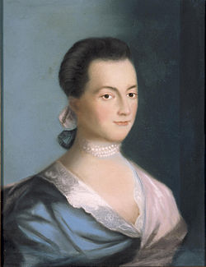
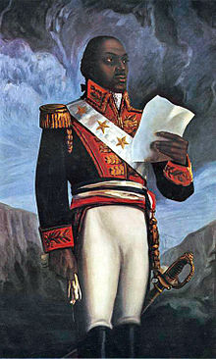
Key Concept 3.2, I Cont.
C) Push for equality during and after Rev. War
The push for equality after the Revolutionary War:
Some individuals called for the abolition of slavery
Pennsylvania’s Gradual Abolition Law (1780):
Prohibited importation of slaves into PA
ALL children born in PA would be free, regardless if their parents were slaves
Model for other northern states to follow
Increased calls for greater political democracy:
Abigail Adams’ “Remember the Ladies”
Judith Sargent Murray advocated education for females
D) Republican Motherhood
Women were expected to instill republican values in children and families
Increased educational opportunities for women
E) Impact of the American Rev. and D.O.I. on the world?
Inspired revolutions across the world
French Revolution in 1789
Haiti – Toussaint L’Ouverture helped Haiti gain independence in 1804
Latin America – many Spanish colonies gained independence in the early 19th century

Slide 5
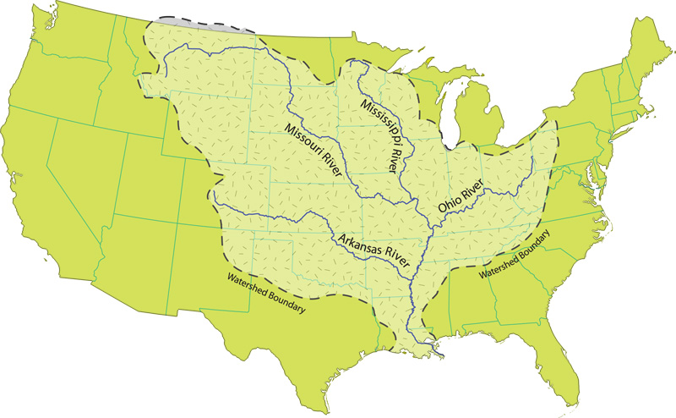
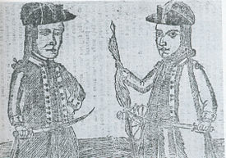
Key Concept 3.2, II
“After declaring independence, American political leaders created new constitutions and declarations of rigts that articulated the role of the state and federal governments while protecting individual liberties and limiting both centralized power and excessive popular influence.” - Page 39 of the Curriculum Framework
A) Politics of state constitutions
Feared strong centralized power a la Britain
Articles and state constitutions had strong legislative branches
Property requirements for voting and citizenship – fear of the masses
B) Challenges under the Articles:
Trade: each state could places tariffs on goods from other states – discouraged trade between states
Finances: each state could coin its own $ - differing values, high inflation in some states, also discouraged trade
Many states had debt from Revolutionary War – increased taxes
Federal government could not require taxes
Foreign Relations:
Britain – refused commercial treaties with US, Congress could not control commerce (sanctions against Britain)
Spain – cut off access to Mississippi River
Both countries supplied Native Americans with weapons
Internal unrest:
Shays’ Rebellion: - MA farmers demanded debt relief, attacked court houses
These challenges helped many Americans realize a stronger central government was needed……..

Slide 6
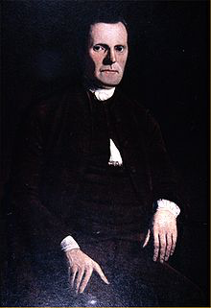
Key Concept 3.2, II Cont.
C) Constitution created a limited government that embodied federalism and separation of powers
Federalism – division of power between state and federal governments
Specific powers for both the federal and state governments
D) Constitutional compromises
Great Compromise (Connecticut Compromise) – Roger Sherman
Combined VA Plan (large-states) and NJ Plan (small-states)
Created a bicameral legislature with one house based on population (House of Reps) and one with equal representation (Senate)
A census would be taken every ten years to determine population
3/5 Compromise:
For the purpose of representation, 3/5 slaves would count as 1 person in the South
BOTH THE GREAT COMPROMISE AND 3/5 COMPROMISE SETTLED THE ISSUE OF REPRESENTATION
E) Ratification of the Constitution
Federalists (favored) vs. anti-Federalists
Federalist Papers (Hamilton, Madison, and Jay) – written to advocate the ratification of the Constitution
Why was it finally ratified?
Federalists promised to add a Bill of Rights that protected individual rights and restricted powers of the federal government (no quartering troops – 3rd; no search and seizure without warrant – 4th)

Slide 7
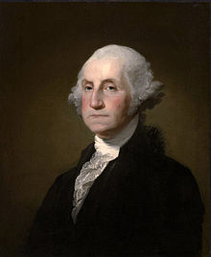
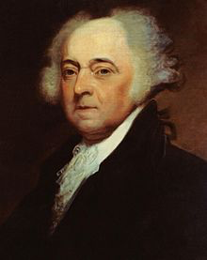
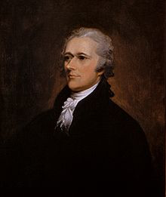
Key Concept 3.2, III
I
trading with Britain!
“New forms of national culture and political institutions developed in the United States alongside continued regional variations and differences over economic, political, social, and foreign policy issues.” - Page 39 of the Curriculum Framework
A) Institutions and precedents established by Washington and Adams
2-term tradition (until the 22nd amendment) by Washington
Creation of the cabinet
Creation of the Bank of the US (BUS) by Alexander Hamilton
B) Emergence of the Federalists (Hamilton) and Democratic-Republicans (Jefferson and Madison)
Relationship between national government and states – Federalists favored a stronger national government, Democratic-Republicans favored a smaller gov
VA and KY Resolutions – belief that states could nullify federal laws
Economic Policy – Hamilton’s Financial Plan (Federalists) would strengthen the federal government – the creation of the BUS was NOT mentioned in Constitution
Hamilton argued the Necessary and Proper, or elastic clause
Foreign Affairs – Federalists favored Great Britain – trade and $, Democratic-Republicans favored France – saw French Rev. as an extension of American Rev.

Slide 8
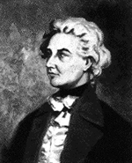
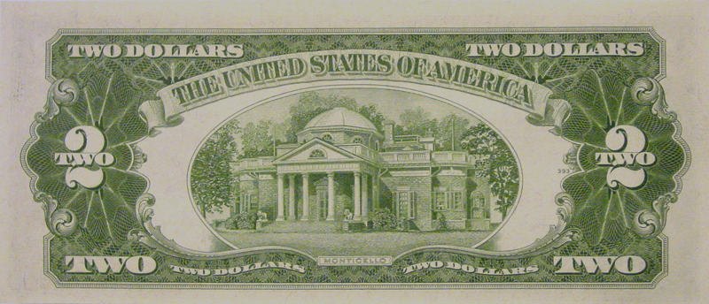
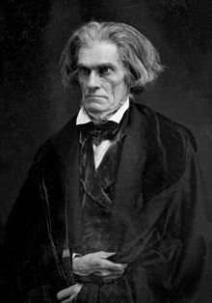
Key Concept 3.2, II Cont.
C) Impacts of the expansion of slavery:
Antislavery sentiment began to grow in the north
Emergence of sectional attitudes towards slavery
South’s transition from “A necessary evil” to “A positive good”
D) National identity seen through:
Art:
Gilbert Stuart – painted portraits of the first 6 presidents
Literature:
Focused on freedom and defining the government
Jefferson’s Virginia Statute for Religious Freedom
Architecture:
Jefferson and Monticello
Pierre Charles L’Enfant and D.C.

Slide 9
Test Tips
Multiple-Choice and Short Answer Questions:
Issues with the Articles of Confederation
Common Sense
Constitutional compromises
Social impacts of the Rev. War
Reasons for the emergence of political parties
Essay Questions:
Revolutionary War as a turning point
Causes for the creation and ratification of the Constitution and its impacts
Reasons for supporting and opposing the Constitution (Compare and contrast)

Slide 10
Short Answer Question
Remember: each part (a, b, c) must be AT LEAST 2-3 sentences.
The Constitutional Convention saw various groups reaching several compromises
A) Briefly explain one compromise reached to form the Constitution.
B) Briefly explain how this compromise satisfied two opposing viewpoints of different groups
C) Briefly explain one long-term success or failure of this compromise.

Slide 11
See You Back Here For Key Concept 3.3!
Thanks for watching
Please subscribe and share
Check out APUSHReview.com for many more resources

